Slide 1
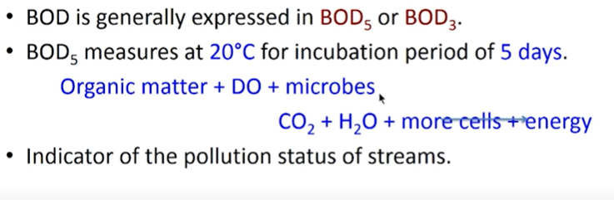
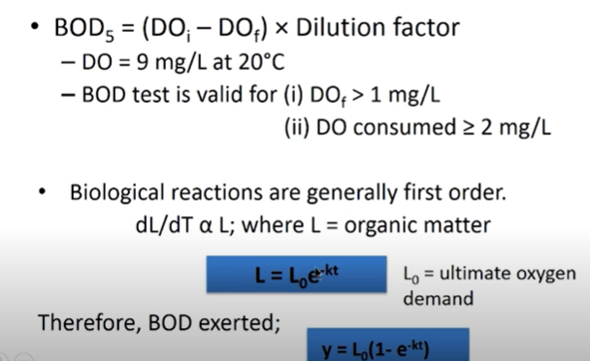
Chemical Parameters

Slide 2
Dilution factor
Dilution factor = (Vs+Vw)/ Vs
Vs is the sample Volume
Vw- Water added
E.g 2% solution means DF= 100/2
3% solution means DF = 100/3
(Sometimes DF would be given in vs/(vs+vw) which will be coming less than 1 as numerator is less than denominator. Then you need to divide DF)

Slide 3
BOD5 = (2/3) BODu (ultimate BOD)
In 5 days almost 2/3 organic matter gets decomposed due to bacteria
In 20 days almost 95-99% Organic Matter gets decomposed by bacteria
The exact amount of decompostion depend on temperature and type of organic matter
ThoD > CoD> BOD

Slide 4
Problems
The dissolved oxygen in an unseeded sample of diluted wastewater having an initial DO of 9.0 mg/L is measured to be 3.0 mg/L after 5 days. The dilution fraction is 0.03 and reaction rate constant k = 0.22 day-1. Calculate a) 5 day BOD of the waste, b) ultimate carbonaceous BOD, and c) What would be remaining oxygen demand after 5 days?
(Hint: Here the dilution is 3% i.e 100/3 )

Slide 5
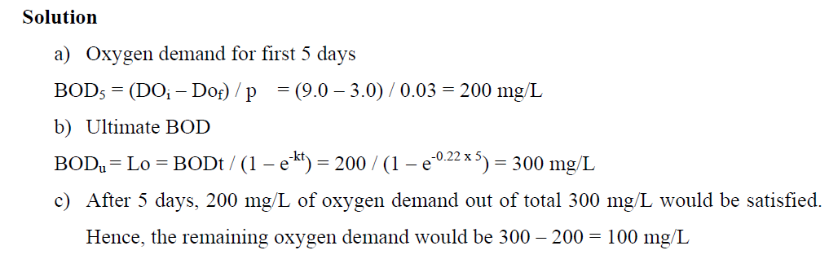

Slide 6
A 10percent concentrationof sample yields that result : initial DO= 8.5mg/lit , final DO= 6.0 mg/lit.

Slide 7
solution
BOD= (initial-final)*DF
= (8.5-6.0)* 10
= 25mg/lit

Slide 8
BOD5 of a waste water is determined to be 150mg/lit at 20 degree C.The value of k is 0.23 per day.determine the ultimate BOD.

Slide 9
BOD_{ultimate} = BOD₅ /(1-e^{-kt} )
=150/(1-e^{-0.23*5} )
=220mg/lit

Slide 10
Noise
Audible pressure range – 20 µpa to 200pa
Minimum pressure to hear –20 µpa – Threshold of hearing
SPL (Sound pressure level) - Pressure that cause a particular sound
SPL = 20 log₁₀ [P/P_{ref}] (P_{ref}- 20 µpa)
(SPL in dB)
Intensity of sound is measured in decible (dB)

Slide 11
Problem
A source emitting 80 dB and 60 dB if put same location will produce a noise of ?

Slide 12
Problem
Source emitting 80 dB and 60 dB if put same location will produce a noise of ?
(you cant add decibel as its log scale. The resultant pressure need to be quantified)
80 dB = 20 log₁₀ (P1/20)
P1 = 200000
60 dB = 20 log ₁₀ (P2/20)
P2 = 20000
Peq = {(200000² + 20000² )}^0.5
= 200997
SPL_{eq} =20 log₁₀ (P_{eq} /20) = 80.09 dB

Slide 13
Note
If two noise sources are of same decibel x. The resultant equivalent SPL will be x+3
e.g 70 db & 70 dB sound, the resultant sound will be 73 db (check by substituting in formula)
2. If the difference between the magnitude of two noise sources is >15 dB. The resultant noise will be the higher value
e.g X1= 60dB, x2= 80 dB, difference is more than 15 db. So the equivalent noise level is 80 dB

